Slide 1
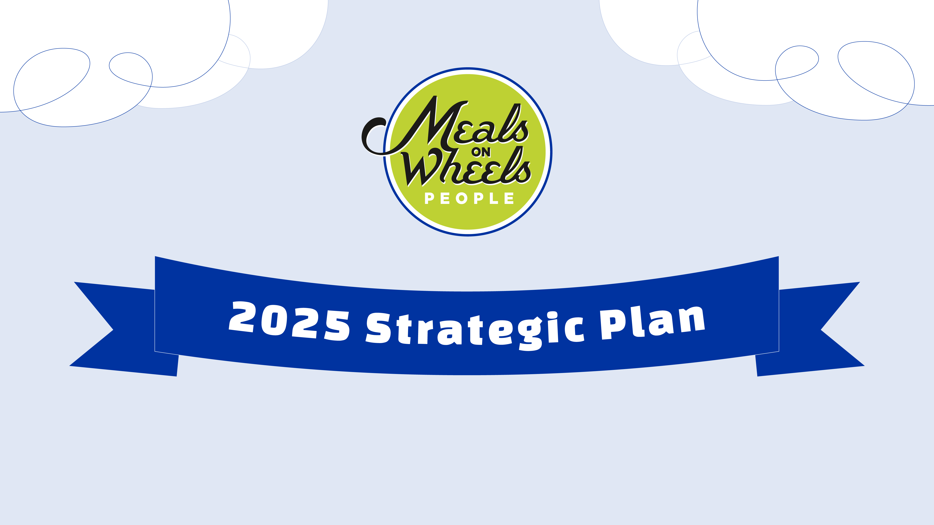

Slide 2
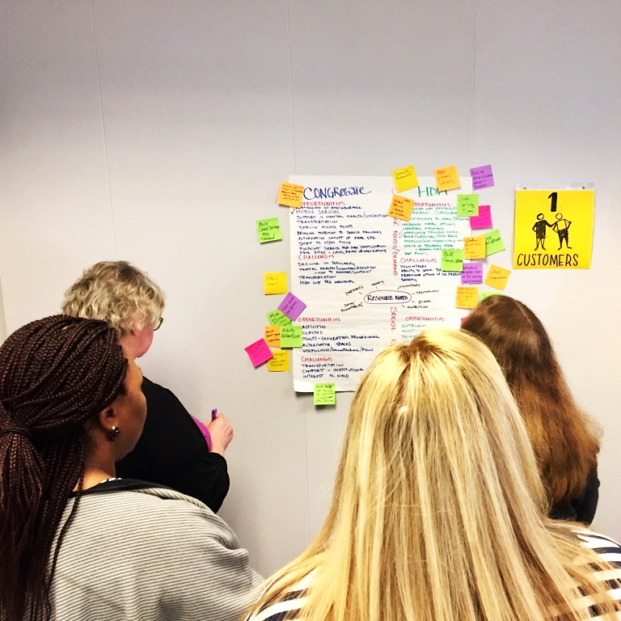
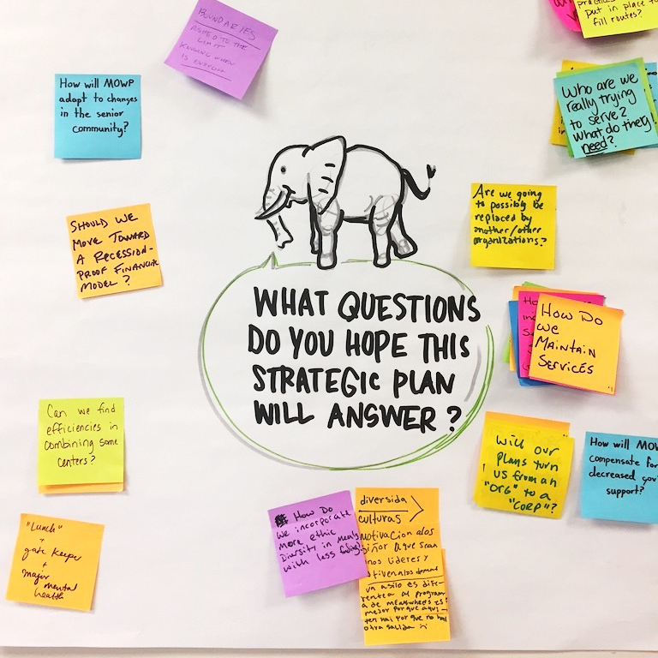
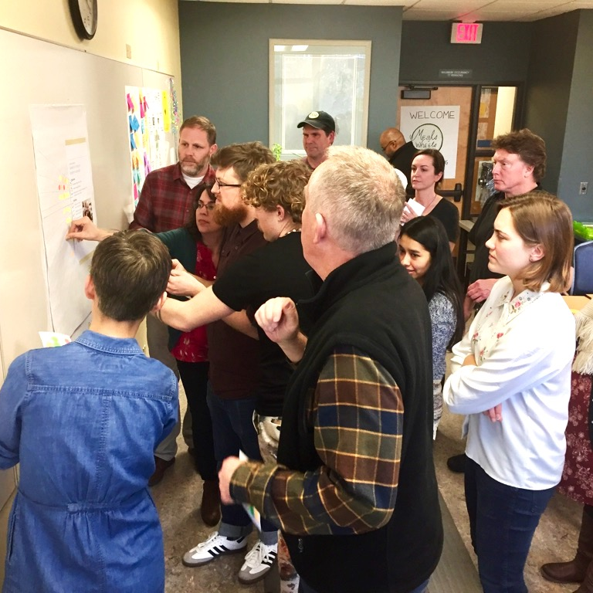
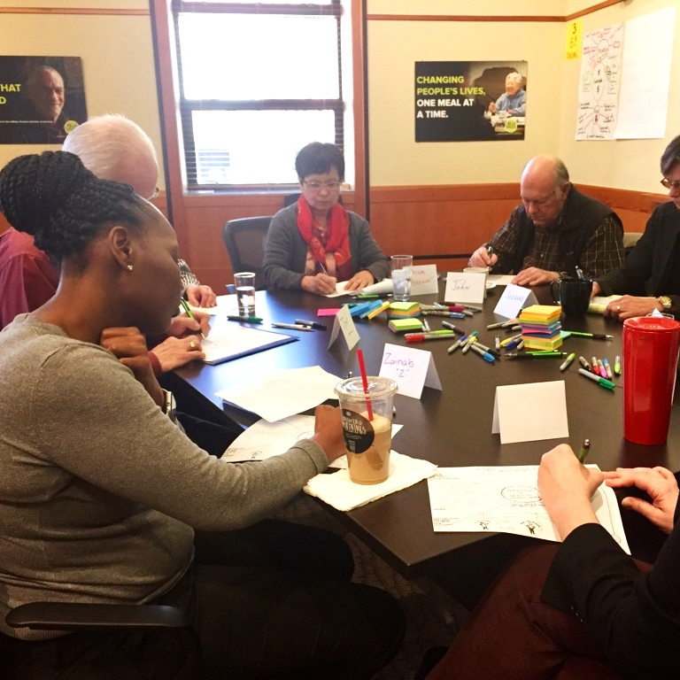
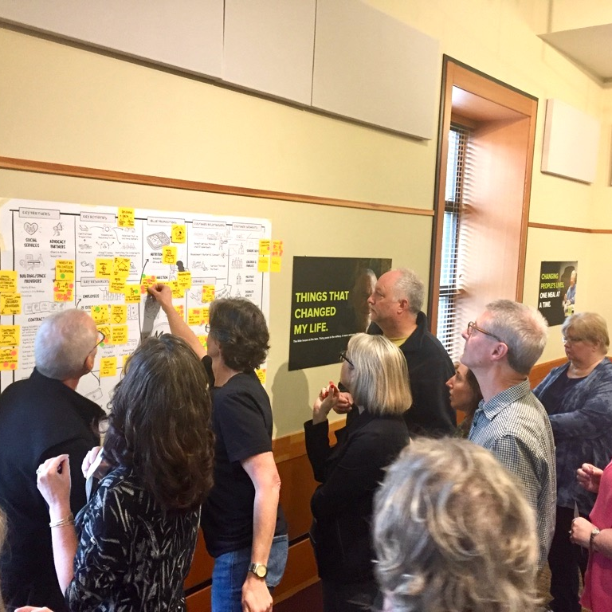
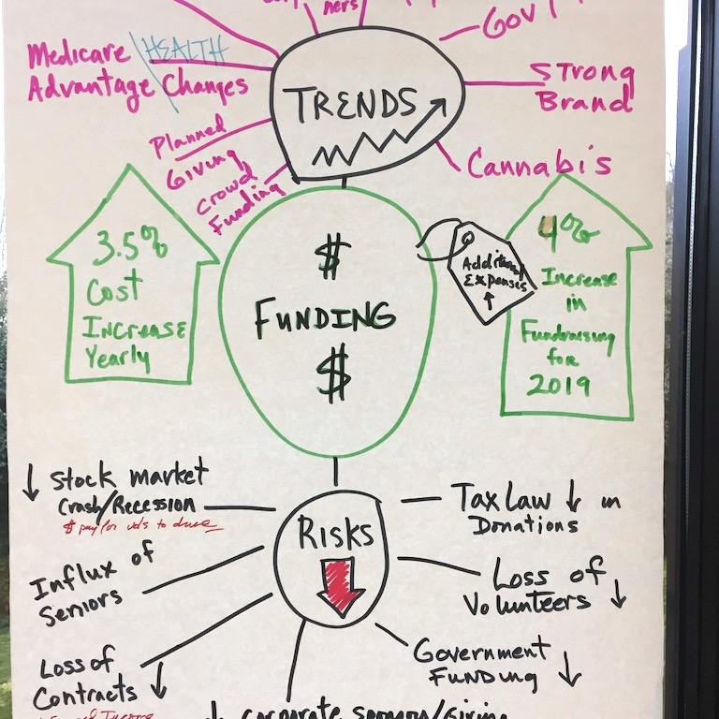
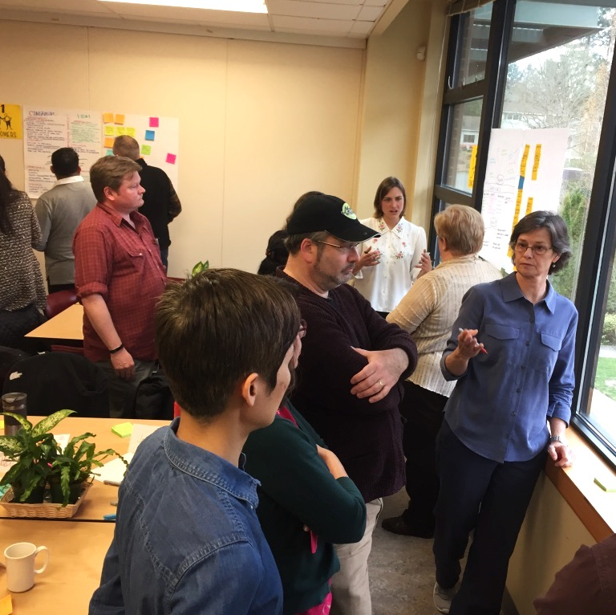
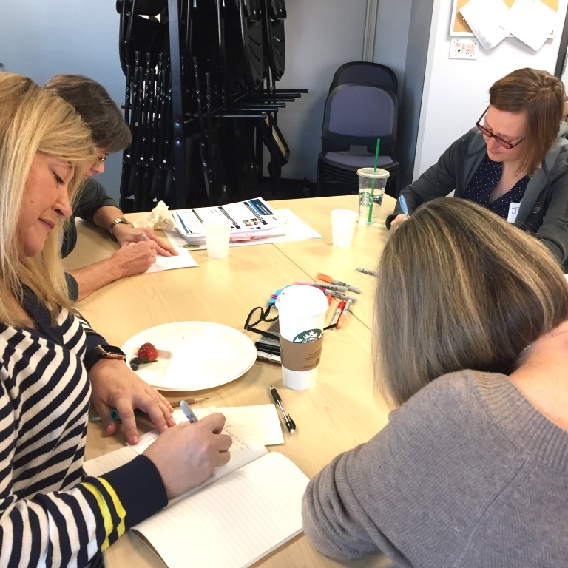
Meals on Wheels People’s new five-year strategic plan begins July 1, 2019.
Our plan was created in Spring 2019 through a collaborative process. We began with a common grounding in our current state and the trends impacting our work over the next 5 years.
We sought perspectives from more than 100 stakeholders, including participants, volunteers, donors, partners and employees. We imagined multiple possible futures, prioritized, scoped, debated, dreamed, clarified, and returned to our mission time
and again. Thank you to our staff and
board for your leadership and
rigorous deliberation.

Slide 3
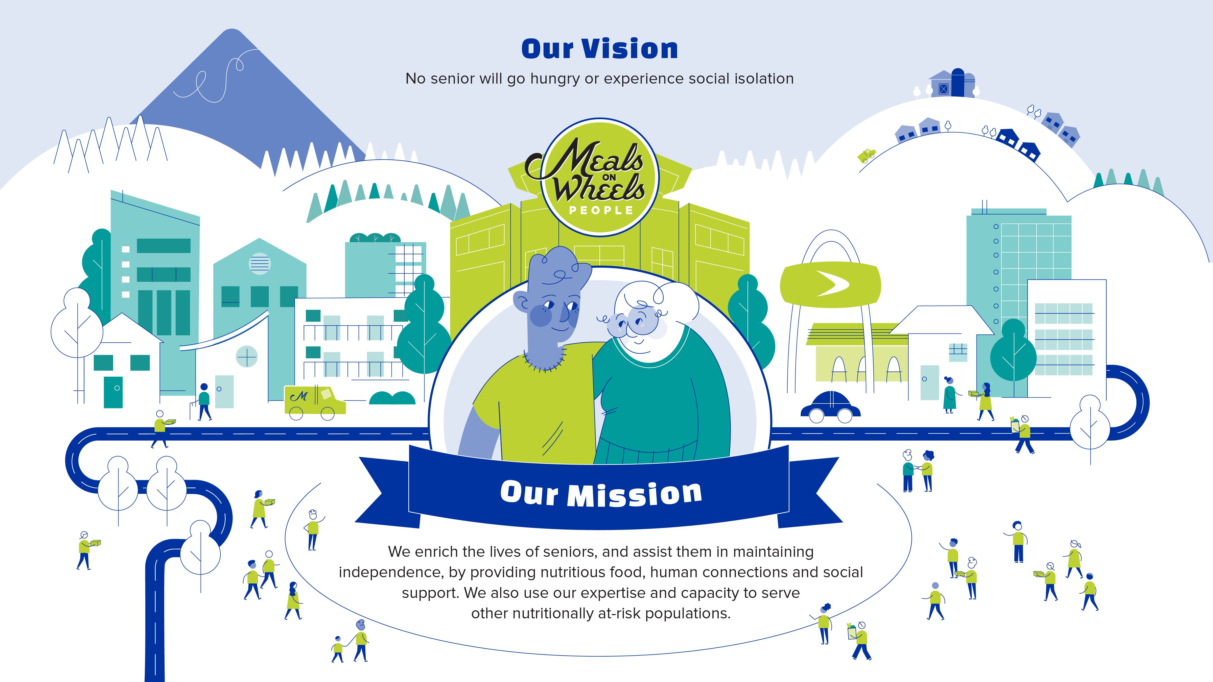
Our strategic plan is intended to provide a road map to organizational sustainability so that we are able to continue the work driven by our mission to realize our vision.

Slide 4
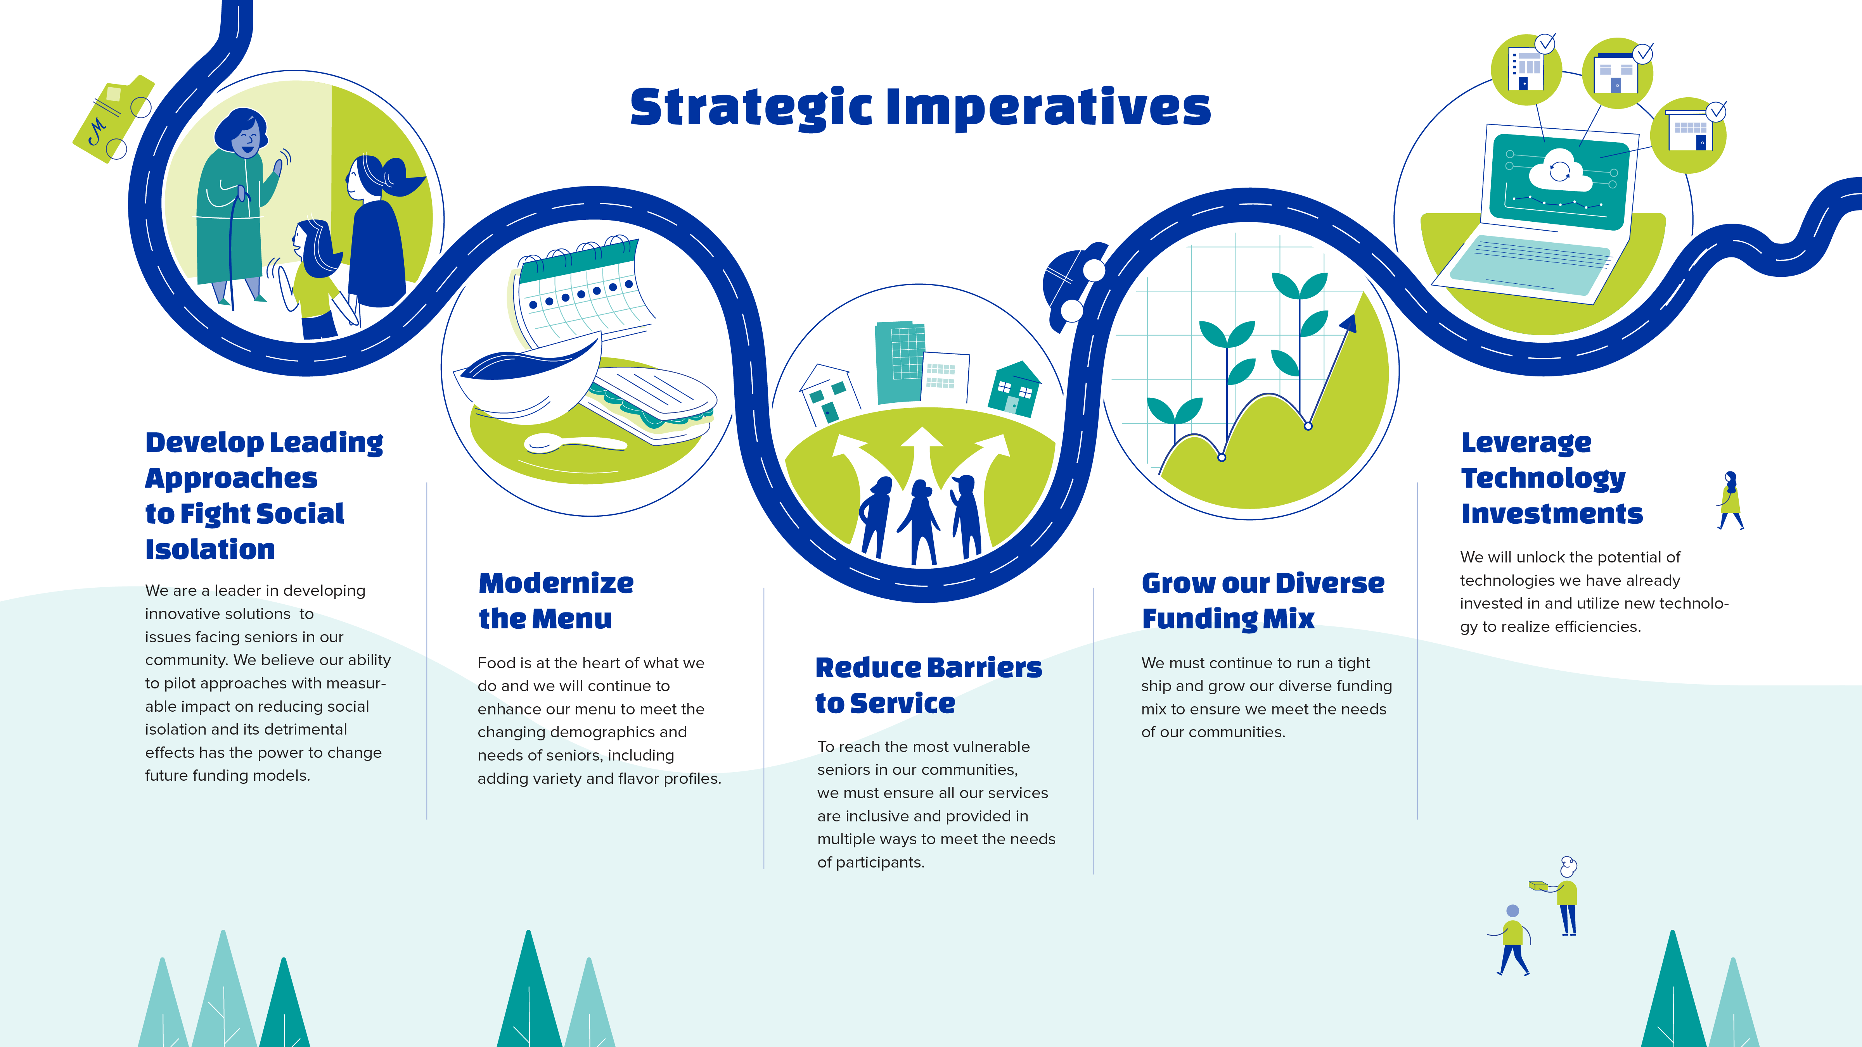

Slide 5
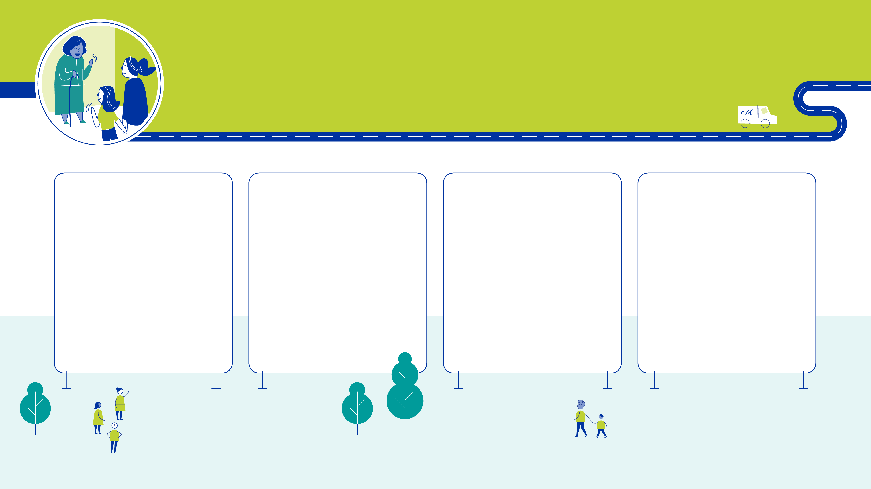
Develop Leading Approaches to Fight Social Isolation
We are a leader in developing innovative solutions to issues facing seniors in our community.
We believe our ability to pilot approaches with measurable impact on reducing social isolation and its detrimental effects has the power to change future funding models.
Congregate Dining Innovation
Experiment with a mix of congregate dining models as funding priorities evolve. Pursue data-driven replication plan for
The Diner.
Participant Connect Program
Establish low and high tech peer-to-peer connection programs for homebound participants.
Intergenerational Visiting Program
Create opportunities for intergenerational visiting programs through family and community partners.
Home Services Experiments
Experiment in pet care, home repair, or other opportunities for financially self-sustaining services that bring increased opportunities for social interactions.

Slide 6
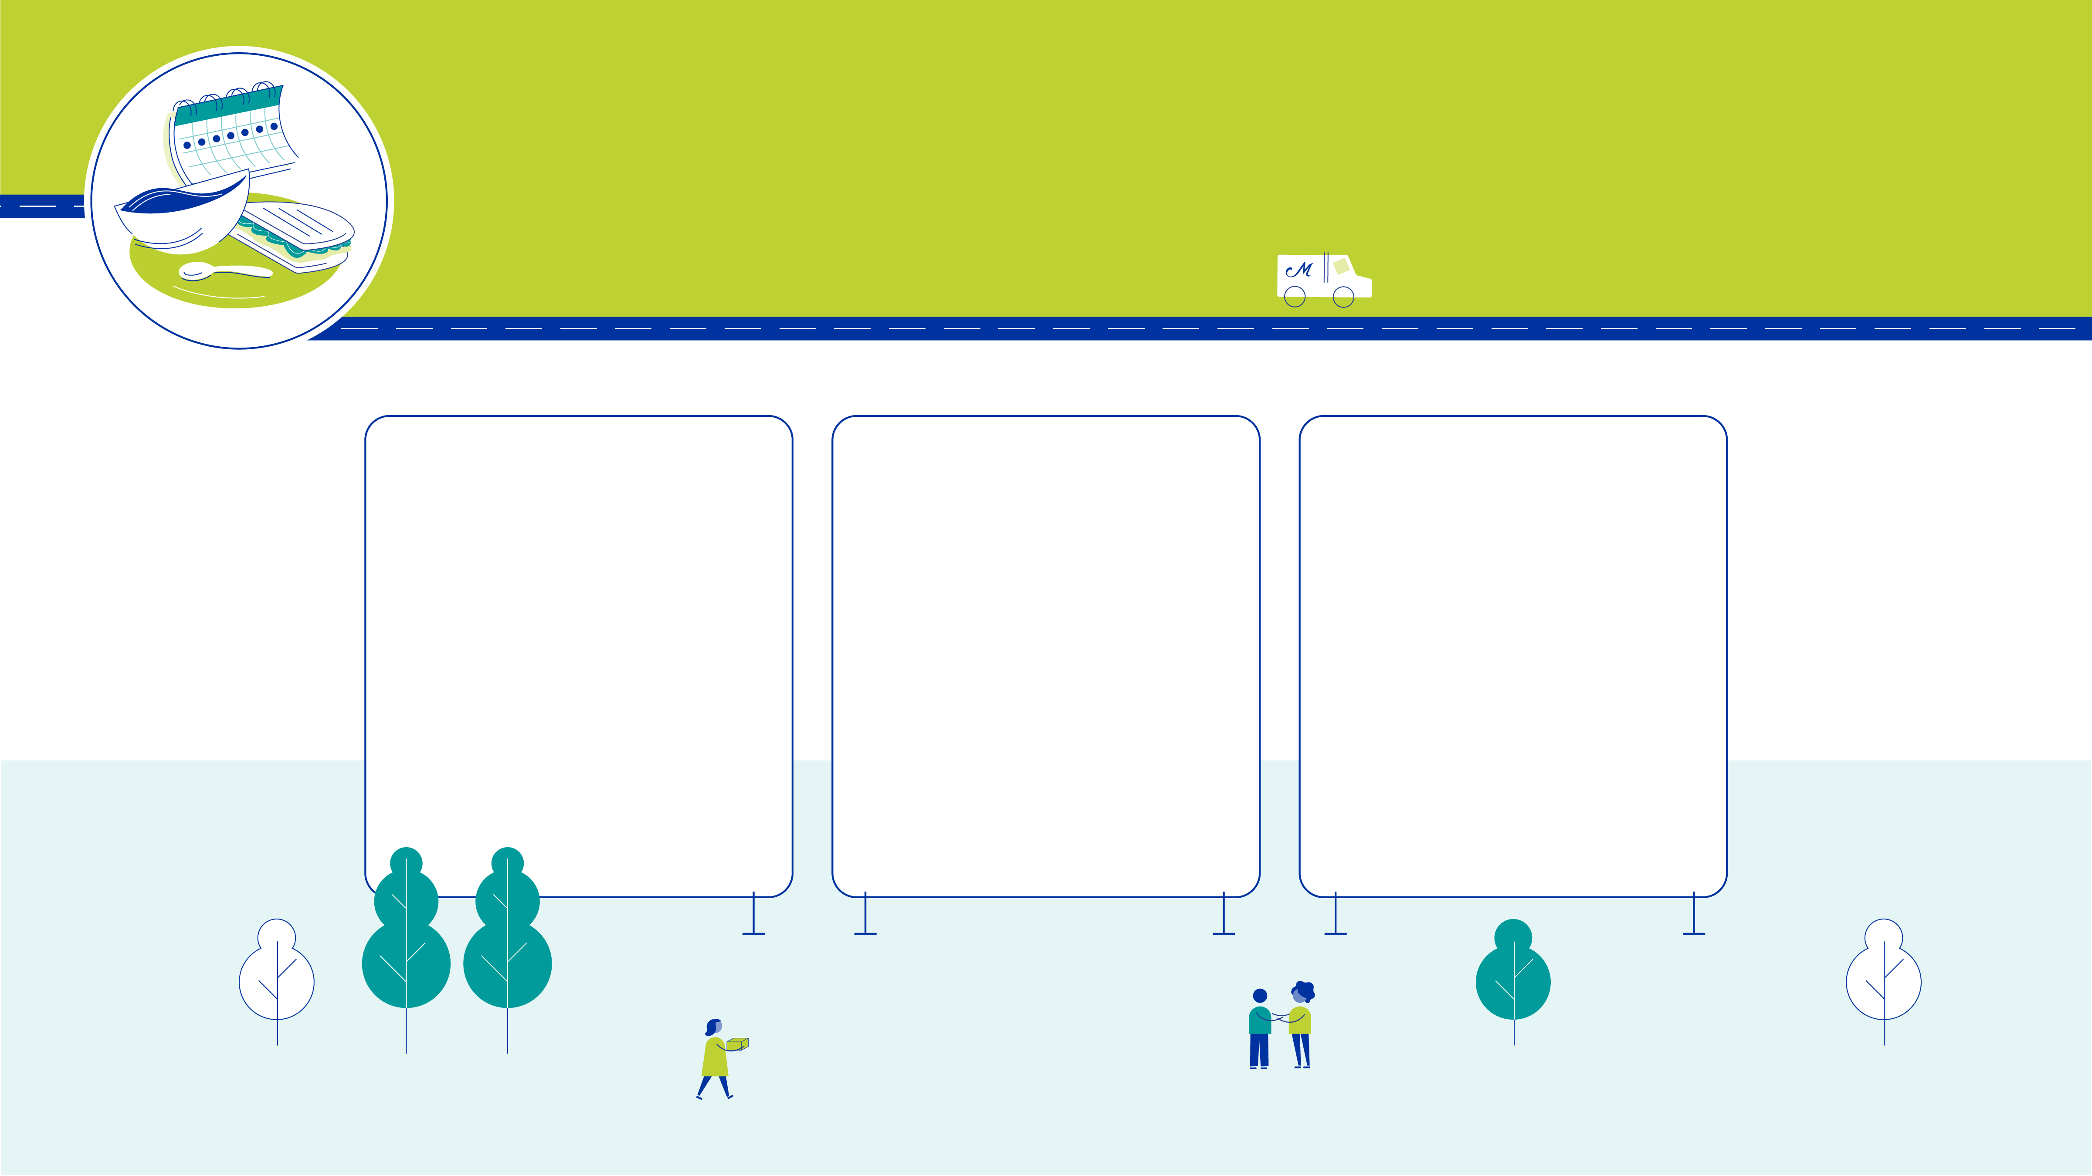
Modernize the Menu
Food is at the heart of what we do and we will continue to enhance our menu to meet the changing demographics and needs of seniors, including adding variety and flavor profiles.
7 day menu
Increase the menu from
5 to 7 days of meals.
Quarterly Seasonal Rotation
Establish a 7 week
cycle with quarterly seasonal rotation to bring in greater variety.
Soup and Sandwich
Create the capability for effective soup and sandwich packing. Introduce soups and sandwiches to the menu to provide more options that meet diverse flavor preferences of participants.

Slide 7
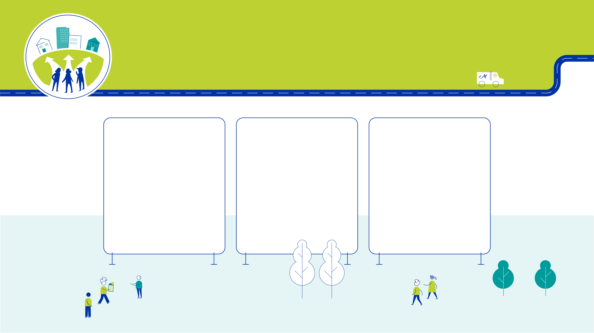
Reduce Barriers to Service
To reach the most vulnerable seniors in our communities, we must ensure all our services are inclusive and provided in multiple ways to meet the needs of participants.
Reach Insular Communities
Increase home
delivery service to socially/culturally insular communities, beginning with a needs assessment.
Inclusive Service Model
Establish alternative service models that
reduce barriers to service (physical, mental,
social, cultural).
Staff, Volunteer, Partner Diversity
Recruit and support socially/culturally diverse staff, volunteers, and partners who reflect the diversity and speak the language of communities most in need.

Slide 8
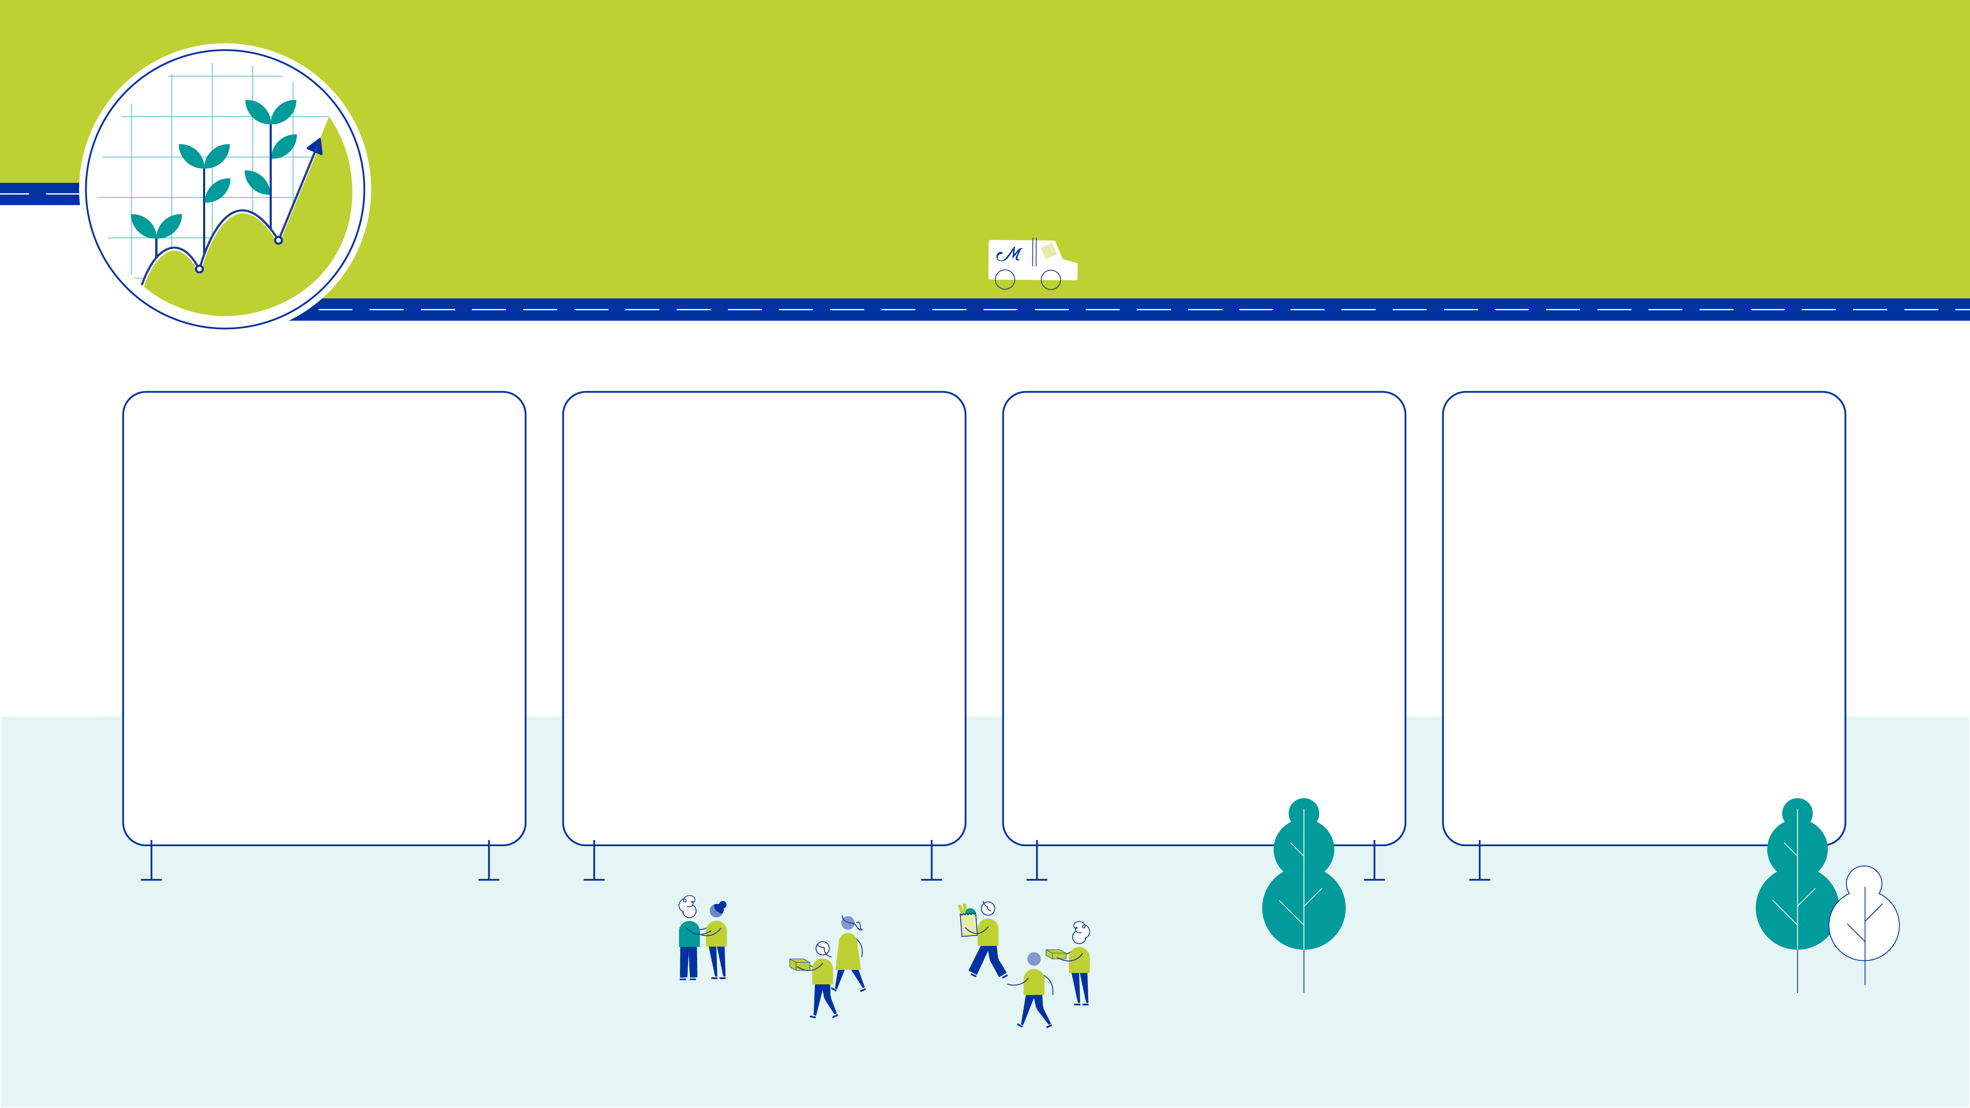
Grow our Diverse Funding Mix
We must continue to run a tight ship and grow our diverse funding mix to ensure we meet the needs of our communities.
20% Earned
Income Expansion
Expand Earned Income by 20% by experimenting and evaluating ROI on earned income portfolio, including: co-packing, PDXPOP!, central kitchen leasing, meal sales, healthcare meal provision contracts, and others.
Kitchen Modernization
Obtain FSMA accreditation for central kitchen to expand co-packing opportunities.
Effective Contracts
Evaluate and negotiate with contract partners/locations to ensure value.
Cultivate Volunteer Base
Identify potential donors within our volunteer base
and cultivate those who are interested in extending
their contribution beyond volunteer service.

Slide 9

Leverage Technology Investments
We will unlock the potential of technologies we have already invested in and utilize new
technology to realize efficiencies.
Ordering & Production Modernization
Increase efficiencies by connecting meal forecasting tools in ServTracker with the production capabilities of Food Service Suite. Improve the current processes, reporting, and training.
Integrated Volunteer and Donor Systems
Connect Raiser’s Edge with VolunteerHub to sync users, event registrations, hours, and to more thoughtfully engage volunteers as donors of time and dollars.
Streamlined Billing & Invoicing
Analyze current processes and leverage tools to achieve an efficient, consistent billing structure of our contracts.

Slide 10
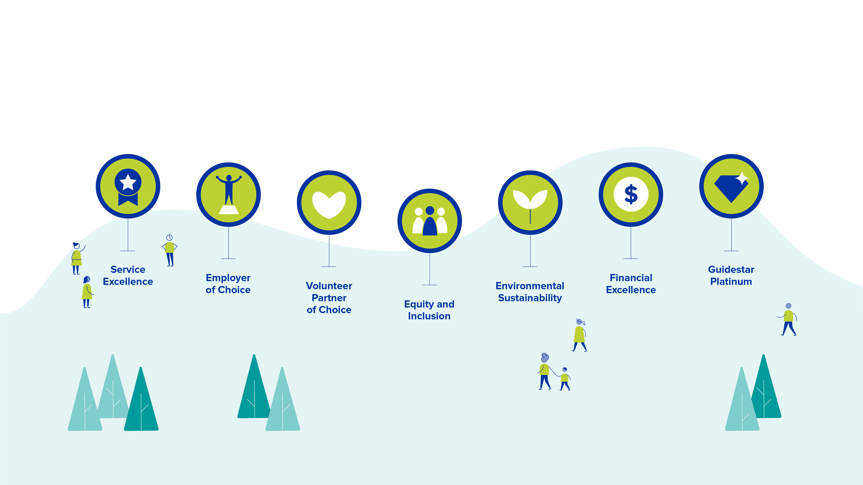
Evergreen Commitments

Slide 11
Why this plan? Why now?
While all of America is aging, with 10,000 people turning 65 every day, Oregon and Washington’s numbers are outpacing other states. It is projected that Oregon’s 65 and older population will increase nearly 100% by 2030 and by 138% by 2050.
Currently, 1 in 6 seniors residing in Oregon is food insecure and in Washington, the figure is 1 in 8. These seniors are living on a fixed income averaging only $1,400 per month. It is reported that 52% of baby boomers have little or no retirement and that social security makes up 90% of their income. The constant increases to the cost of living are outpacing any gains to our participants’ income, making it increasingly difficult to afford basic needs such as food and housing. We must be prepared to meet the needs of these older adults.
Senior isolation, in particular, is has become a serious health issue for older Americans. More than a quarter of seniors live alone, and 43% report feeling lonely on a regular basis. Isolation has the health impact of smoking 15 cigarettes per day, with increased risk of high blood pressure, depression, dementia, malnutrition and other harmful health issues. Isolated seniors are more vulnerable to elder abuse. In order to reduce isolation and allow seniors to continue to thrive and remain independent in their own homes, we are committed to developing leading approaches to fight social isolation.
We believe the five imperatives and evergreen commitments of our plan focus us on the right strategies to address these profound needs of the community we serve.

Slide 12
CURRENT STATE
Starting from
a position of strength
We entered strategic planning with a
strong, successful operating model.
This is a snapshot of how our organization
runs today.

Slide 13
FUTURE STATE
How much change should I expect?
Most of what we do so well today will continue in the future. Our strategy amplifies our strengths and pushes us to adjust to changing needs and opportunities.

Slide 14
How does this plan build on our work the last three years?
Over the last year we provided pilot programs – the BOLD Seniors project using technology to connect homebound seniors; the Mobile Home Services project to build community within the mobile home community; and we opened The Diner Vancouver. We will continue to enhance services through constant improvement and innovation to ensure we provide the best possible services.
We increased the diversity of our menu by 35% during the last strategic plan, which we will build upon in the new plan by creating a seven-day menu with a seasonal rotation and the ability to provide a soup and sandwich menu to the homebound.
Our earned income has increased 37% over the past three years. The new plan sets the goal of achieving an additional 20% growth. This will provide the resources we need to meet the growing need for senior meals, support our staff and volunteers and maintain our ability to try new programs.
Implementation of Volunteer Hub now provides for an easier onboarding of volunteers and our ability to offer richer and more varied opportunities, thus increasing the overall support system. In the new plan our volunteer and fundraising systems will integrate to further expand our capabilities.
The new plan utilizes our strong staff support structure, gained efficiencies and increased capacity to pilot new programming and implement meaningful changes with the least disruption.
Over the last 3 years, we fully implemented the living wage plan, enhanced employee benefits and significantly improved overall employee engagement and satisfaction. Without great employees, we are not able to provide great service – we will continue to identify ways to enhance the employee experience.
We will continue to advance equity, inclusion and diversity by addressing historical and institutional barriers that have created disparities for those we serve – clients, staff and volunteers.
Elevating our brand has resulted in new donors and new volunteers thus expanding our overall fundraising ability and our ability to attract and retain excellent staff and volunteers. The new plan will continue to focus on brand enhancement.
The new plan recognizes our financial excellence and will focus on maintaining that excellence as well as our Guidestar Platinum rating.

Slide 15
FAQs
How did we decide
these initiatives?
Our strategic planning committee, comprised of staff and board members, considered a wide range of proposed initiatives that emerged from visioning workshops with over 100 staff, volunteers, community partners, and board members. We worked with Future Work Design, an independent strategy facilitator, to prioritize which initiatives would have the biggest impact on our ability to deliver on our mission.
We heard loud and clear from our staff that we want to maintain focus and not take on too much, so we prioritized carefully and feel confident that the strategic imperatives
and supporting initiatives are the right level of effort for an organization of our size over
5 years.
What strategies are underway already, but not included in this plan?
Medical Meals – We are waiting to hear back on a pilot program before proceeding with this initiative.
Summer Meals for Kids – A pilot project is currently underway.
Generate Revenue from
Cannabis Industry – We plan to investigate selling PDXPOP in
cannabis stores.
What other strategies did you consider, but did not include in this plan?
Fee-for-Service Pet Food/Care – we believe this initiative would require a great deal of time, energy and money. While still an important issue, other priorities rose to the top.
Feeding the Homeless – we currently feed the homeless through several of our contracts as well as a pilot program that provides supplemental meals to homeless participants at the Elm Court Center, however, we believe that expanded service to this population would place an extreme burden on both fundraising and current capacity.
Food Trucks and Mobile Meals – Both of these projects are cost-prohibitive and present a number of challenges.

Slide 16
Staff FAQs
Will we be able to serve more seniors?
The new strategic plan will enable us to serve all those who need us and serve those in need with greater impact.
What is in it for me?
Further stabilization and sustainability of the organization and pride in providing the best service possible as we all work together to change lives one meal at a time!
Does it harm or help me? Will I make more money?
Part of the plan is to increase sustainability and continue to be an Employer of Choice; including competitive wages, benefits and employee assistance programs that support work-life balance.
Does the new plan provide advancement opportunities?
The plan includes a number of new programs, which will provide greater opportunities for, training, development, experience and
job growth.
How can I be involved?
Staff will have opportunities to get involved in the initiatives within the plan and provide input for continual process improvement year over year. We will offer direct opportunities for you to be involved in development and implementation of programming you care about e.g., programs to reduce social isolation or initiatives to evolve the menu. Policies and procedures may change as projects are implemented that may affect you – so we encourage you to get involved to help in the development of new initiatives and programs!
Will we be hiring more people?
The probability is high that we will need to employ new staff to implement new projects, such as the new Outreach Worker added to the 2020 budget who will begin to identify approaches to reaching underrepresented communities.
Is this different or is it adding to my current duties?
Depending on your position, your job duties may change. There is no intent to overload anyone – the intent is to provide the best service possible, which also means providing you with the tools and support to be your best.
How will we do this?
With each new program or initiative, we will identify what the strategy is, why it was selected, how we will measure success and what it will cost.

Slide 17
Volunteer FAQs
What does Volunteer Partner of Choice mean?
Volunteers are the heart and soul of Meals on Wheels People and we are committed to offering you a variety of meaningful volunteer opportunities aligned with your passions and skills, side by side with others who are changing lives one meal at a time. We are also committed to providing you with the tools you need to make your volunteer experience the best it can be, such as the training and education in areas that impact the communities we serve.
What do you want from me?
Awareness and understanding! Ask questions so you can share with others and help answer questions. We also want your input and engagement! You will have opportunities to get involved in the initiatives within the plan that are important to you and provide input for continual improvement year over year.
When will new programs start?
We are currently working on outlining new initiatives. We will keep you informed and will provide you with opportunities for continued engagement, to provide input in the development
of programs and feedback on continuous improvement year over year.
Who do I contact for more information and opportunities to be involved?
Contact your location manager or email volunteer.support@mowp.org
What impact will this have on me/how will
this affect me?
Nothing will change now, more to come as it is developed in the 5-year plan.
What kind of training do I need?
If needed, additional training provided in a variety of methods will be made available to volunteers who choose to participate.

